Slide 1
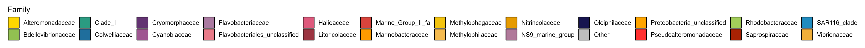
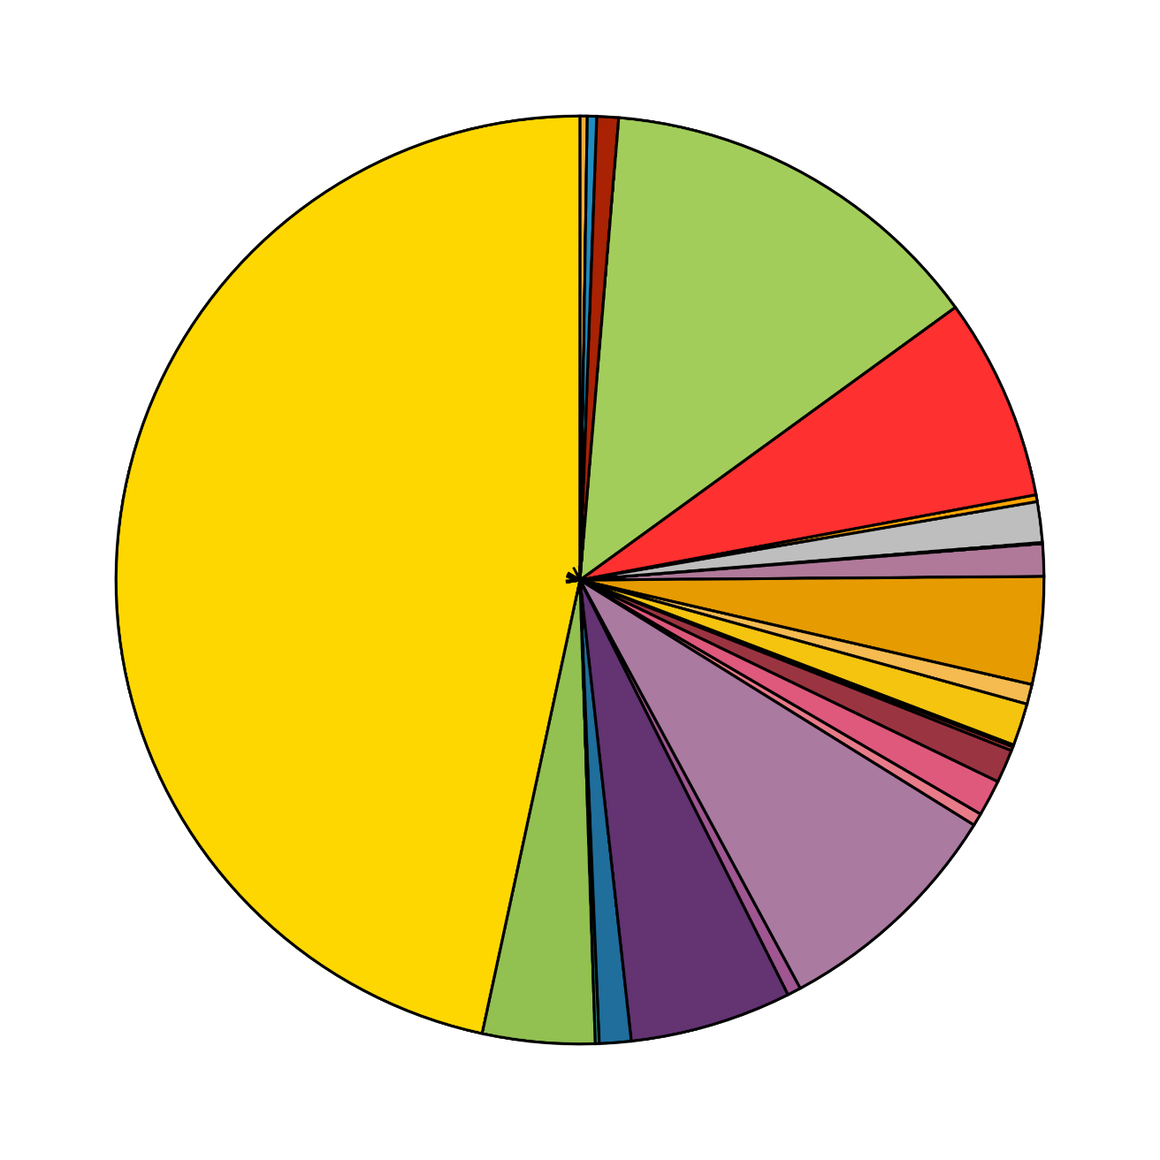
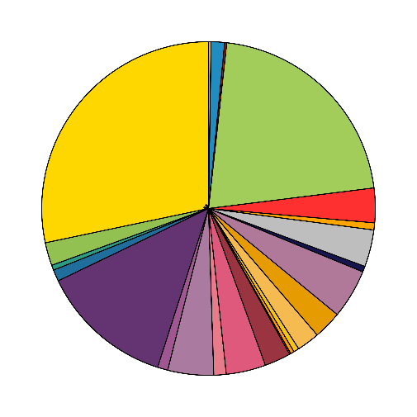
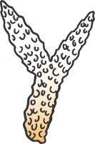
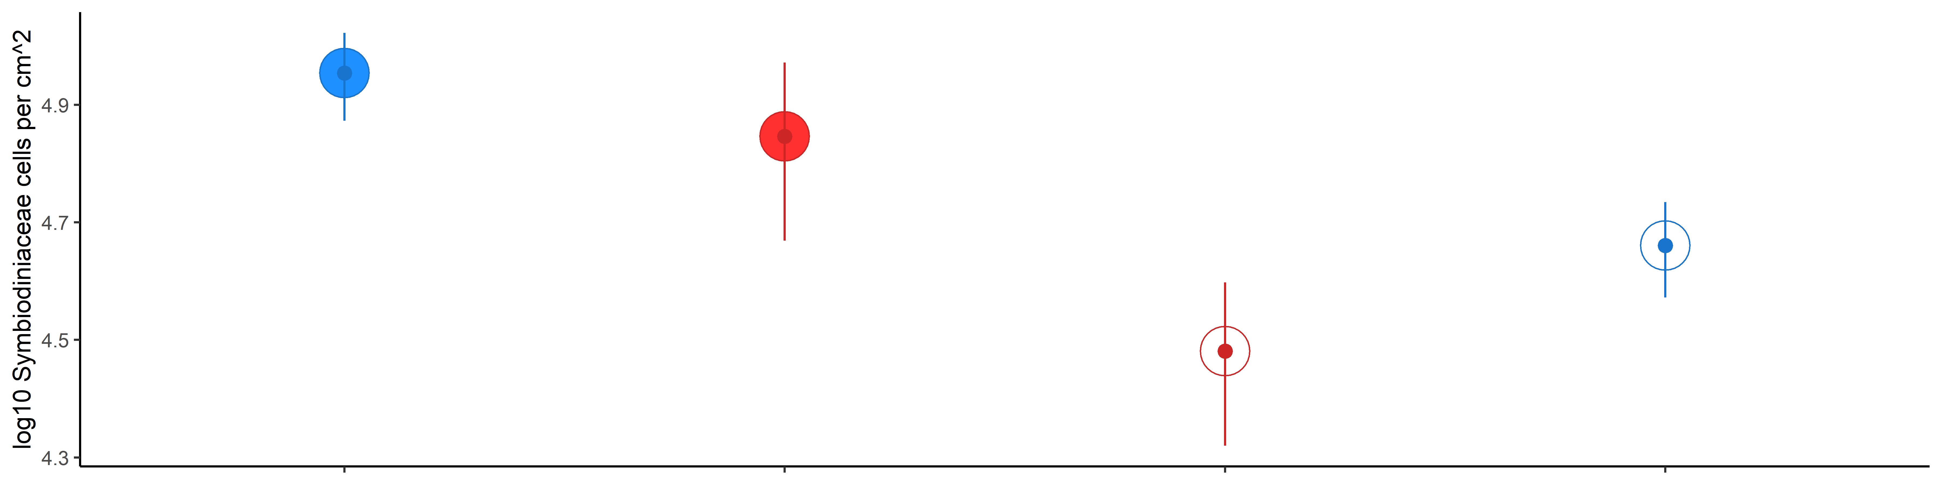
Microbialized
Alteromonadaceae
Pseudoalteromonadacea
Healthy
Hypoxia, disease
Flavobacteriaceae
DOM
DOM
DOM
DOM
“Healthy”
“Thermal Stress Onset”
“Peak Bleaching”
“Recovering”
Non-bleached + Ambient
Non-bleached + Heated
Bleached + Heated
Bleached + Ambient
Symbiodiniacceae Concentration in Coral Tissue
Temperature stress
Time

